Slide 1
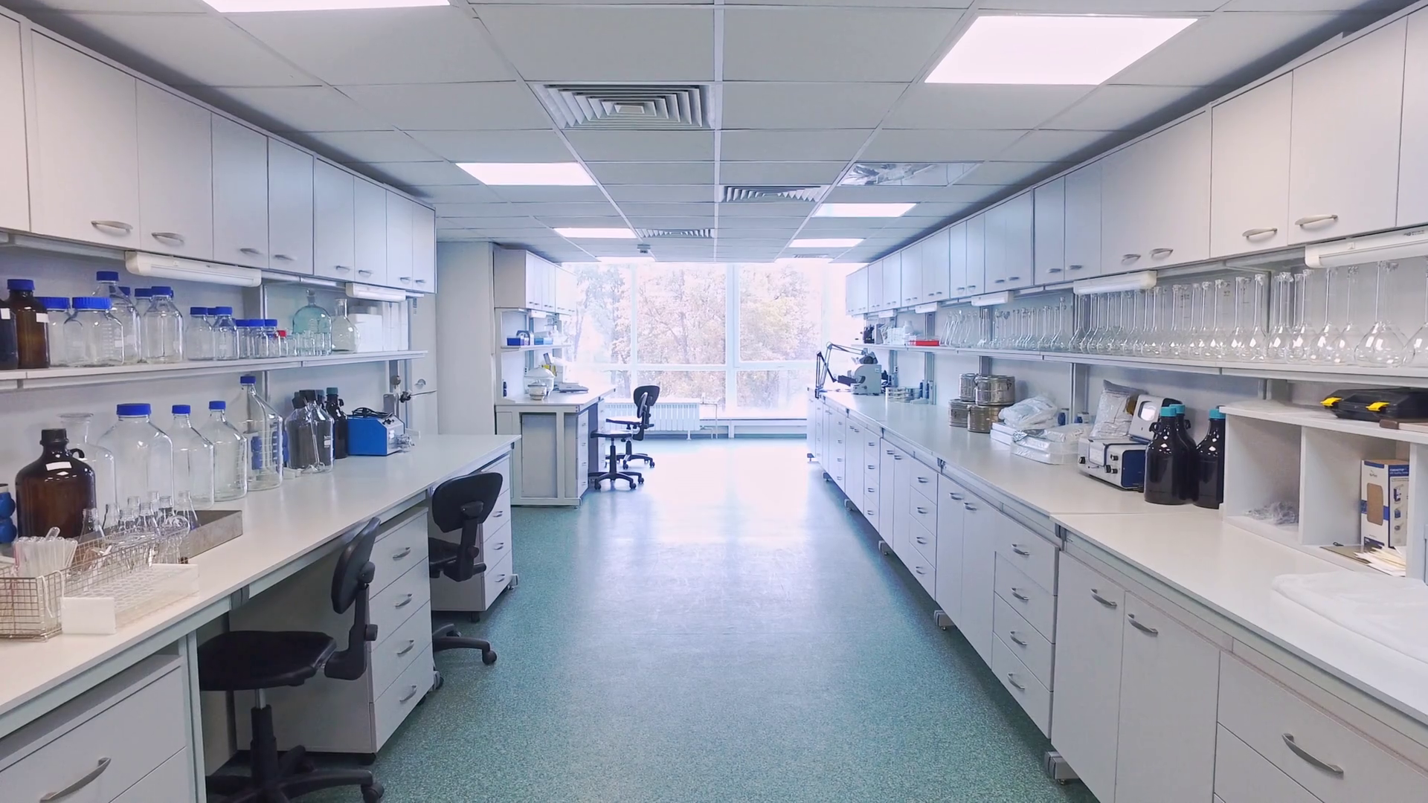
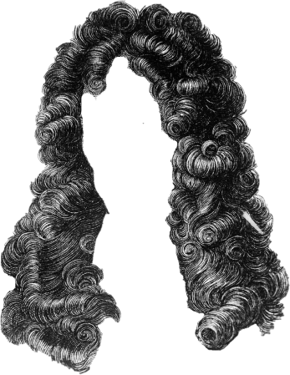



Slide 46
Hey

Slide 47
Hey guys

Slide 48
Hey guys, I’m

Slide 49
Hey guys, I’m mr.

Slide 50
Hey guys, I’m mr.Boy

Slide 51
Hey guys, I’m mr.Boyle

Slide 52
Hey guys, I’m mr.Boyle and

Slide 53
Hey guys, I’m mr.Boyle and I di

Slide 54
Hey guys, I’m mr.Boyle and I discov

Slide 55
Hey guys, I’m mr.Boyle and I discovered

Slide 56
Hey guys, I’m mr.Boyle and I discovered that

Slide 57
Hey guys, I’m mr.Boyle and I discovered that sound

Slide 58
Hey guys, I’m mr.Boyle and I discovered that sound needs

Slide 59
Hey guys, I’m mr.Boyle and I discovered that sound needs a me

Slide 60
Hey guys, I’m mr.Boyle and I discovered that sound needs a medium.

Slide 61
Hey guys, I’m mr.Boyle and I discovered that sound needs a medium.

Slide 62
Hey guys, I’m mr.Boyle and I discovered that sound needs a medium.

Slide 63
Hey guys, I’m mr.Boyle and I discovered that sound needs a medium.

Slide 64
Hey guys, I’m mr.Boyle and I discovered that sound needs a medium.

Slide 65
Hey guys, I’m mr.Boyle and I discovered that sound needs a medium.

Slide 66
Hey guys, I’m mr.Boyle and I discovered that sound needs a medium.

Slide 67
Hey guys, I’m mr.Boyle and I discovered that sound needs a medium.

Slide 68
Hey guys, I’m mr.Boyle and I discovered that sound needs a medium.

Slide 69
Hey guys, I’m mr.Boyle and I discovered that sound needs a medium.

Slide 70
Hey guys, I’m mr.Boyle and I discovered that sound needs a medium.

Slide 71
Hey guys, I’m mr.Boyle and I discovered that sound needs a medium.

Slide 72
Hey guys, I’m mr.Boyle and I discovered that sound needs a medium.

Slide 73
Hey guys, I’m mr.Boyle and I discovered that sound needs a medium.

Slide 74
Hey guys, I’m mr.Boyle and I discovered that sound needs a medium.
That’s

Slide 75
Hey guys, I’m mr.Boyle and I discovered that sound needs a medium.
That’s all

Slide 76
Hey guys, I’m mr.Boyle and I discovered that sound needs a medium.
That’s all ver

Slide 77
Hey guys, I’m mr.Boyle and I discovered that sound needs a medium.
That’s all very in

Slide 78
Hey guys, I’m mr.Boyle and I discovered that sound needs a medium.
That’s all very
inter

Slide 79
Hey guys, I’m mr.Boyle and I discovered that sound needs a medium.
That’s all very interesting,

Slide 80
Hey guys, I’m mr.Boyle and I discovered that sound needs a medium.
That’s all very interesting, but

Slide 81
Hey guys, I’m mr.Boyle and I discovered that sound needs a medium.
That’s all very interesting, but tod

Slide 82
Hey guys, I’m mr.Boyle and I discovered that sound needs a medium.
That’s all very interesting, but today

Slide 83
Hey guys, I’m mr.Boyle and I discovered that sound needs a medium.
That’s all very interesting, but today I

Slide 84
Hey guys, I’m mr.Boyle and I discovered that sound needs a medium.
That’s all very interesting, but today I wan

Slide 85
Hey guys, I’m mr.Boyle and I discovered that sound needs a medium.
That’s all very interesting, but today I want to

Slide 86
Hey guys, I’m mr.Boyle and I discovered that sound needs a medium.
That’s all very interesting, but today I want to talk

Slide 87
Hey guys, I’m mr.Boyle and I discovered that sound needs a medium.
That’s all very interesting, but today I want to talk abo

Slide 88
Hey guys, I’m mr.Boyle and I discovered that sound needs a medium.
That’s all very interesting, but today I want to talk about

Slide 89
Hey guys, I’m mr.Boyle and I discovered that sound needs a medium.
That’s all very interesting, but today I want to talk about the

Slide 90
Hey guys, I’m mr.Boyle and I discovered that sound needs a medium.
That’s all very interesting, but today I want to talk about the phys

Slide 91
Hey guys, I’m mr.Boyle and I discovered that sound needs a medium.
That’s all very interesting, but today I want to talk about the physics

Slide 92
Hey guys, I’m mr.Boyle and I discovered that sound needs a medium.
That’s all very interesting, but today I want to talk about the physics pro

Slide 93
Hey guys, I’m mr.Boyle and I discovered that sound needs a medium.
That’s all very interesting, but today I want to talk about the physics project

Slide 94
Hey guys, I’m mr.Boyle and I discovered that sound needs a medium.
That’s all very interesting, but today I want to talk about the physics project of

Slide 95
Hey guys, I’m mr.Boyle and I discovered that sound needs a medium.
That’s all very interesting, but today I want to talk about the physics project of
gro

Slide 96
Hey guys, I’m mr.Boyle and I discovered that sound needs a medium.
That’s all very interesting, but today I want to talk about the physics project of
group

Slide 97
Hey guys, I’m mr.Boyle and I discovered that sound needs a medium.
That’s all very interesting, but today I want to talk about the physics project of
group 24.

Slide 98
Hey guys, I’m mr.Boyle and I discovered that sound needs a medium.
That’s all very interesting, but today I want to talk about the physics project of
group 24.

Slide 99
Hey guys, I’m mr.Boyle and I discovered that sound needs a medium.
That’s all very interesting, but today I want to talk about the physics project of
group 24.

Slide 100
Hey guys, I’m mr.Boyle and I discovered that sound needs a medium.
That’s all very interesting, but today I want to talk about the physics project of
group 24.

Slide 101
Hey guys, I’m mr.Boyle and I discovered that sound needs a medium.
That’s all very interesting, but today I want to talk about the physics project of
group 24.

Slide 102
Hey guys, I’m mr.Boyle and I discovered that sound needs a medium.
That’s all very interesting, but today I want to talk about the physics project of
group 24.

Slide 103
Hey guys, I’m mr.Boyle and I discovered that sound needs a medium.
That’s all very interesting, but today I want to talk about the physics project of
group 24.

Slide 104
Hey guys, I’m mr.Boyle and I discovered that sound needs a medium.
That’s all very interesting, but today I want to talk about the physics project of
group 24.

Slide 105
Hey guys, I’m mr.Boyle and I discovered that sound needs a medium.
That’s all very interesting, but today I want to talk about the physics project of
group 24.

Slide 106
Hey guys, I’m mr.Boyle and I discovered that sound needs a medium.
That’s all very interesting, but today I want to talk about the physics project of
group 24.

Slide 107
Hey guys, I’m mr.Boyle and I discovered that sound needs a medium.
That’s all very interesting, but today I want to talk about the physics project of
group 24.

Slide 108
Hey guys, I’m mr.Boyle and I discovered that sound needs a medium.
That’s all very interesting, but today I want to talk about the physics project of
group 24.

Slide 109
Hey guys, I’m mr.Boyle and I discovered that sound needs a medium.
That’s all very interesting, but today I want to talk about the physics project of
group 24.

Slide 110
Hey guys, I’m mr.Boyle and I discovered that sound needs a medium.
That’s all very interesting, but today I want to talk about the physics project of
group 24.

Slide 111
Hey guys, I’m mr.Boyle and I discovered that sound needs a medium.
That’s all very interesting, but today I want to talk about the physics project of
group 24.

Slide 112
Hey guys, I’m mr.Boyle and I discovered that sound needs a medium.
That’s all very interesting, but today I want to talk about the physics project of
group 24.

Slide 113
Hey guys, I’m mr.Boyle and I discovered that sound needs a medium.
That’s all very interesting, but today I want to talk about the physics project of
group 24.

Slide 114
Hey guys, I’m mr.Boyle and I discovered that sound needs a medium.
That’s all very interesting, but today I want to talk about the physics project of
group 24.

Slide 115


Slide 127


Slide 131
TADA!

Slide 132
TADA!

Slide 133
TADA!

Slide 134
TADA!

Slide 135
TADA!

Slide 136
TADA!

Slide 137
TADA!

Slide 138
TADA!

Slide 139
TADA!

Slide 140
TADA!

Slide 141
TADA!

Slide 142
TADA!

Slide 143




